Slide 1


50 BEDED UPAZILA HEALTH COMPLEX
Chowgacha, Jessore.
Dr. Md Emdadul Haque
Chowgacha UHC, Jessore.

Slide 2
A Sub-district level Women-Friendly Hospital with a Vision …
Maximum utilization of Govt.
resources with
honesty and sincerity
Integrated approach of
Administration, Community
Leaders & Health
Management
Providing Effective and
prompt services
through improved
management system

Slide 3
Health Profile of Chowgacha Upazila- 2011
Total population : 247887
Total Fertile Couples : 53033
Total Pregnant : 5264
Total Delivery : 4475
Total Live birth : 4389
Total death : 1009
Total Maternal death : 03
Health Man power
a. Doctor : 12 (10+2)
b. Nurse : 18(14+4)
c. HA : 25
d. SBA : 13( 3HA+10 FWA )
e. Volunteer, Security guard & cleaner: 52
9. Health Institutions
a. Health Complex : 01
b. H & FWC : 11 (RD- 4 + FWC– 7 )
c. Community clinic : 23
d. Non- Govt. Clinic : 04

Slide 4
10. Mother Taken-ANC 1st : 170% (8935)
11. Hospital Delivery Rate : 98.6% (4413)
12. Total C. Section rate : 22.5% (1007)
13. Total C. Section rate of
Chowgacha Mothers : 12.8% (575)
14. No. of Hospital bed : 50
15. Bed Occupancy Rate : 208%
16. CPR : 69%
17. CBR : 17.7 /1000 population
18CDR : 4.1 /1000 population
19. Population Growth Rate : 1.36 %
20. Maternal Mortality Ratio : 68 / 100000 live birth
21. Neonatal Mortality Rate : 18.2 / 1000 live birth
22. Infant Mortality Rate : 23.6 /1000 live birth
23. Under-5 Mortality Rate : 25.7 /1000 live birth

Slide 5
Background History of MCH services of Chowgacha Health Complex, Jessore
To reduce Maternal and Child Mortality and Mobility and to ensure the quality services to the mother and child, UHFPO opened 4 special activities headed by medical officers in Feb. 1996. And from January 1995 to 1997 JICA helped us by Frontline MCH Program to implement the program by giving technical and logistic supports. Since 1998 DGHS & UNICEF have continued the
support.
<4 Special activities>
ANC-Corner – leaded by female Medical Officer for pregnant mother for effective ANC services who receive TT immunization in the Health Complex
Basic EOC service by a Gyne & Obs. trained MO
Under 5 corner for under 5 children for their nutritional assessment and treatment by RMO.
Monthly birth and death record by specially developed format by health assistant throughout the Upazilla to asses the progress of maternal and child health status by health indicators supervised by UH&FPO

Slide 6
Contd.
From Dec. 1999 Reproductive Health Department of DGHS and UNICEF gave logistic supports and human resources development (like medical officer trained in anesthesia).
Form November 2000 started Comprehensive EOC program.
In 2004, 2005, 2006, 2007 , 2008, 2009 , 2010,2011,2012&,2013 the UHC was awarded by the Bangladesh Government and UNICEF for best performance on EOC Service.
From August 2006 Safe Blood Transfusion unit established with the aid of UNICEF.
From April 2007 Demand Side Financing (DSF) program started.
Women friendly Hospital declared in 2008.
Hospital is declared as model health complex on 20 June 2008 and upgraded to 50 bedded hospital by Secretary of Ministry of Health & family welfare.
Chowgacha health complex Model is replicable through out the country. Declared by Dr. Margaret Chan, D.G. WHO on 8th March 2010.
Major Killer Disease (diabetes, hypertension, cancer, RTA & poisoning) prevention program starts in 1st January-2011.
TQM activates starts in July 2011 by the support of JACA.

Slide 7
Upazila Health Complex
CHOWGACHA , JESSORE.
Emergency & Out door Service 2005 to 2011
Sl No | Year | Emergency Patients | Out door Service
01 | 2005 | 4308 | 80591
02 | 2007 | 4287 | 105963
03 | 2008 | 4275 | 120117
04 | 2009 | 5144 | 126369
05 | 2010 | 7071 | 95958
06 | 2011 | 6318 | 91638

Slide 8
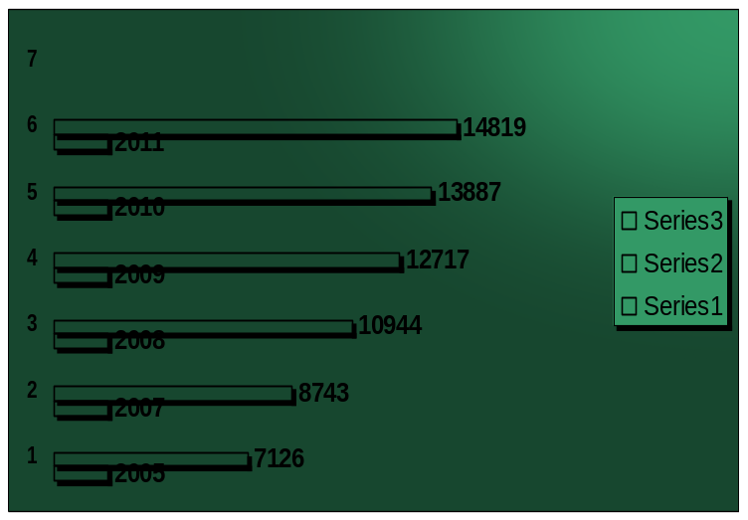
Upazila Health Complex
CHOWGACHA , JESSORE.
Indoor Service 2005 to 2011
Sl No | Year | indoor Service | No of Bed | Bed occupancy rate
01 | 2005 | 7126 | 31 | 158.0%
02 | 2007 | 8743 | 31 | 201.0%
03 | 2008 | 10944 | 50 | 199.0%
04 | 2009 | 12717 | 50 | 185.0%
05 | 2010 | 13887 | 50 | 200.0%
06 | 2011 | 14819 | 50 | 208.0%

Slide 9

Upazila Health Complex
CHOWGACHA , JESSORE.
EOC Activities : 1997- 2011 (ANC First Visit)

Slide 10
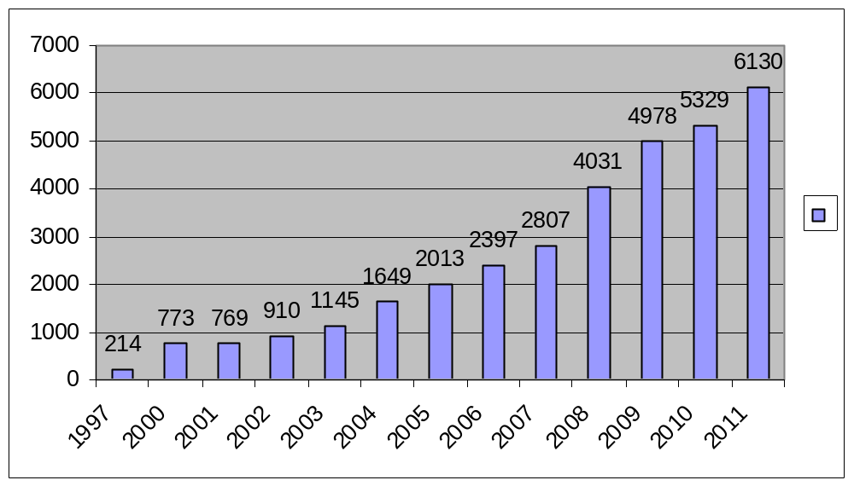
Upazila Health Complex
CHOWGACHA , JESSORE.
EOC Activities : 1997- 2011 (Admission in labour ward

Slide 11
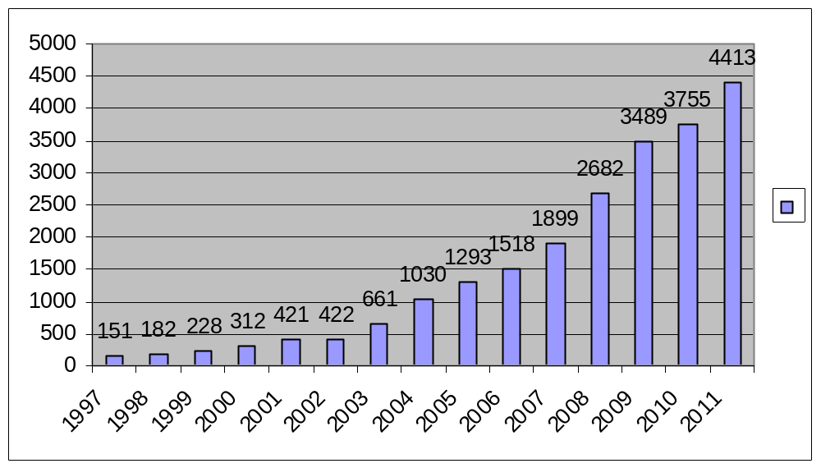
Upazila Health Complex
CHOWGACHA , JESSORE.
EOC Activities : 1997- 2011 (Hospital Delivery )

Slide 12

Upazila Health Complex
CHOWGACHA , JESSORE.
EOC Activities : 2000 - 2011 (Caesarian Section)

Slide 13
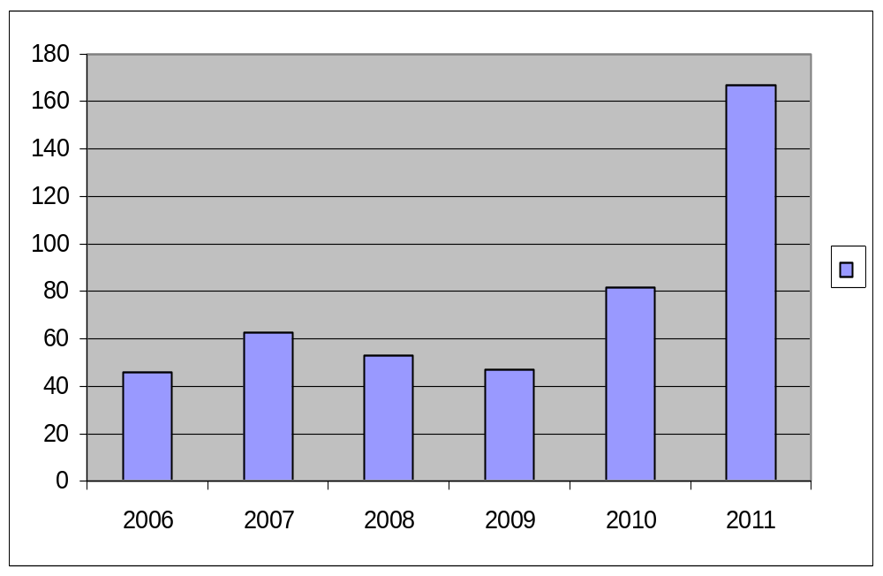
Upazila Health Complex
CHOWGACHA , JESSORE.
EOC Activities : 2006 - 2011 (Caesarian Tubectomy)
167
2011
82
63
53
46
47

Slide 14
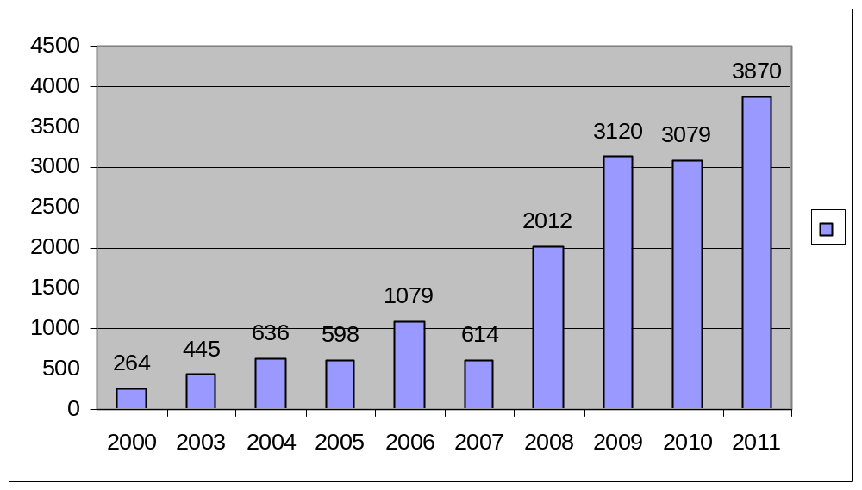
Upazila Health Complex
CHOWGACHA , JESSORE.
EOC Activities : 1997- 2011 (PNC )

Slide 15
Upazila Health Complex
CHOWGACHA , JESSORE.
Progress Of EOC Activities based on UN Process Indicators
SL No | Indicators | 2005 | 2007 | 2008 | 2009 | 2010 | 2011 | Target of UN Process
01 | Total Pregnancy | 5270 | 5489 | 5793 | 5595 | 5208 | 5264 | -
02 | Total Hospital delivery | 1293 | 1899 | 2682 | 3489 | 3755 | 4413 | -
03 | Total Caesarian section | 310 | 473 | 567 | 842 | 962 | 1007 | -
04 | Maternal death in health Complex. | 03 | 01 | 3 | 0 | 0 | 3 | -
05 | % of birth in health Complex. | 26.5% | 38.1% | 52.4% | 72% | 84.8 | 98.6 | >15%
06 | Met-need for EmOC | 92.1% | 107% | 175 % | 232% | 267% | 263% | 100%
07 | Caesarian section of all births | 6.3% | 9.7% | 11% | 17.3% | 21.7% | 22.5%* | 5-15%
08 | Case Fatality Rate | 0.44% | .13% | 0.20% | 0.0% | .0% | 0.38% | <1%
* Among the total delivery of Chowgacha Upazilla, the CS rate is 12.8% but CS 9.7% is
increased due to complicated delivery from outside this upazilla.

Slide 16
Upazila Health Complex
CHOWGACHA , JESSORE.
Comparative Data of Delivery of best performing EOC center of Khulna Division in 2011
SL No | Name of institute | NVD | Vacuum Del. | V. Breech | C. Section | Total
01. | Chowgacha UHC | 3346 | 34 | 26 | 1007 | 4413
02. | Ad-din Hospital Jessore. | 1124 | 0 | 0 | 1864 | 3492
03. | Khulna Medical College Hospital | 1581 | 58 | 18 | 1356 | 3013
04. | 250 bed Hospital, Jessore | 1327 | 2 | 25 | 1498 | 2852

Slide 17
Upazila Health Complex
CHOWGACHA , JESSORE.
Comparative Data of Delivery of best performing EOC center of Khulna Division in 2017
SL No | Name of institute | ANC | NVD | C. Section | Total
01 | Ad-din Hospital Jessore. | 23981 | 640 | 3075 | 3715
02 | Jhenaidah Sadar Hospital | 15360 | 1839 | 1143 | 2997
03 | 250 bed Hospital, Jessore | 13152 | 1327 | 1778 | 2967
04 | Chowgacha UHC | 18650 | 2163 | 759 | 2922
05 | Khulna Medical College Hospital | 6977 | 1455 | 1228 | 2683
06 | 250 Bedded Hospital, Kushtia | 4735 | 1595 | 919 | 2514

Slide 18


Upazila Health Complex
CHOWGACHA , JESSORE.
Under 5 Service (2009-2011).
S. No | Year | Admission in indoor |  |  |  |  | Outdoor
 |  | Male | Female | Total | Death | Refer
1 | 2009 | 1416 | 855 | 2271 | 20 | 55 | 24776
2 | 2010 | 1733 | 1124 | 2897 | 8 | 66 | 20919
3 | 2011 | 1458 | 1013 | 2471 | 11 | 73 | 21312

Slide 19
MDG 4 and 5 Achieved at Chowgacha in 2011 and SDG targets in 2030
Per 1000 live Birth Chowgacha MDG Target SDG Target
MMR: .68 1.47 .70
(MDG 5 Achieved)
NNMR: 18.2 - 12
IMR: 23.6 31 -
(MDG 4 Achieved)
<5 MR: 25.7 50 25
(MDG 4 Achieved)

Slide 20
Upazila Health Complex
CHOWGACHA , JESSORE.
COMMUNITY SUPPORTED MANPOWER
TOTAL :46
  Volunteers :26
  Cleaners & guards :16
  Others :04
  The remunerations come from
  Outsourcing :25
  Service provider :21
  The amount of remuneration ranging from 200/= To 8000/=tk. Per month depending upon the style of work, which costs a total of nearly 90,ooo/=Tk per month.

Slide 21
Achievement of Chowgacha Health Complex
From 1996 to 2012, took initiatives to develop Upazilla level standard services in Chowgacha health complex.
In 2010, Chowgacha Health Complex declared as the model upazilla health complex.
Mobilized 46 additional workers from community (26 volunteer, 12 cleaners and others 8).
EOC Beds increased from 11 to 41
Chowgacha UHC became the best EOC center with 98.4% delivery rate
Chowgacha UHC nearly achieved health related SDG target in 2011.
Chowgacha Health complex is awarded for best performance in EOC form 2005 to 2014.

Slide 22



Blood donation program stared in 16 December, 1996 in Chowgacha UHC
A seminar held on basic information system at Chowgacha Degree College in June, 1997. DC Jessore was the chief guest .

Slide 23





Slide 24





Slide 25






Slide 26

Thank you

